Slide 1
Scrum-agile vs. Waterfall
An exploration of roles and processes
Matt Jackson CS-250 Final Project SNHU
Oct 14, 2023 Dantzler

Slide 2
Srcum-Agile Team Roles
Product Owner
Responsible for managing the product backlog, the work to be done organized into user stories. User stories are a way of defining requirements. (Cobb, pp. 35, 40)
Scrum Master
Helps outsiders interact with Scrum Team. Ensure best Scrum practices are followed. Facilitates Scrum events. (Cobb, p. 36)
Tester*
Works collaboratively with developers. Tests as development is happening to ensure user stories are met (concurrent testing) (Cobb, pp. 6, 80)
Developer
*No titles for development team members other than developers. May do different work, or apply special skills, but all are developers. (Cobb, 38)

Slide 3
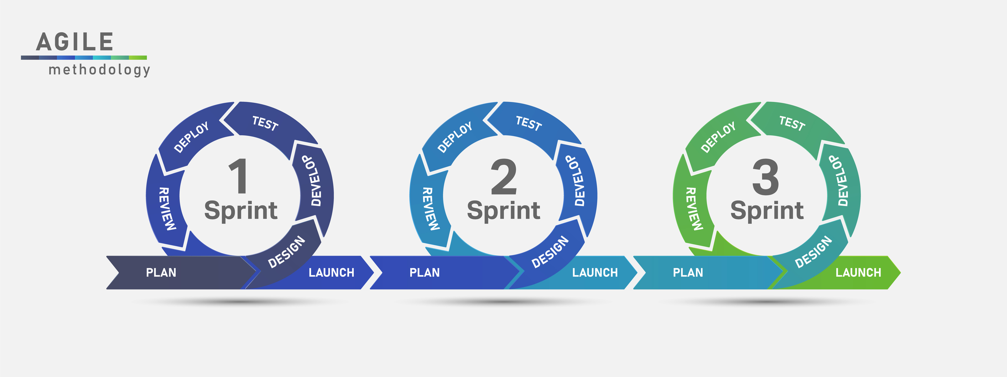
Phases of SDLC in an agile approach

Slide 4
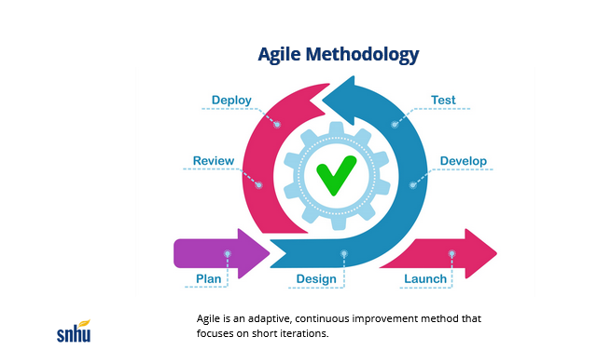
Phases of SDLC in an agile approach
Plan – Gather business requirements
Design – Pre-production version
Develop – Turn requirements to code
Test – Validation. Done with Dev.
Deploy – Product delivered to user
Review – Process improvement
Launch –Product is live

Slide 5
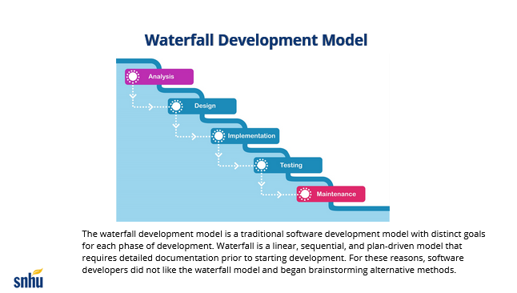
Waterfall
Entire product is developed before customer review / delivery

Slide 6
Agile vs Waterfall
In this project, the primary difference between an agile vs. waterfall approach is that in a waterfall approach, there is no mechanism for customer feedback before the final project is delivered. Here, we would have seen the wrong content slides delivered to the customer (popular destinations vs. wellness / detox trips)
There wouldn’t have been an opportunity to correct this upon delivery in the waterfall method. But with agile, customer feedback was incorporated before launch.

Slide 7
Agile vs. Waterfall
The waterfall approach may be preferred when requirements are solidly defined upfront. Agile is better suited for when these requirements may not be clearly known or subject to change. In the class project, the requirements seemed clear up front, but upon development they changed. The chosen agile approach was better suited in this case. A project where the customer and the provider have worked closely together in the past or the provider has done similar projects may be better suited to the waterfall method- having a proven case-study to base the design and process on could preclude the need for heavy customer involvement during development. A newer team or customer relationship may benefit from the more flexible agile approach.

Slide 8
References
Cobb, Charles G. The Project Manager’s Guied to Mastering Agile. Hoboken, New Jersey: John Wiley & Sons, Inc., 2015.
2023. October 14. http://istockphoto.com.
2023. October 14. http://snhu-media.snhu.edu/files/course_repository/undergraduate/cs/cs250/storyline/mod1/story_html5.html.
Clark, Hannah. “The Software Development Life Cycle (SDLC): 7 Phases and 5 Models.” The Product Managern.d. https://theproductmanager.com/topics/software-development-life-cycle/.

